Slide 1
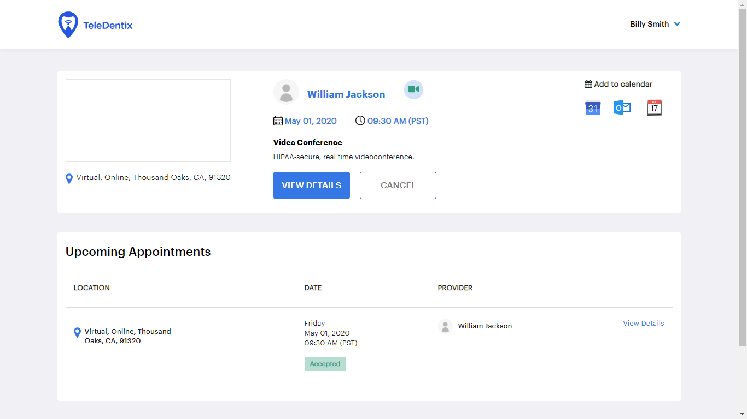
Click on VIEW DETAILS to
Complete or update forms
View any educational materials sent to you
Upload any document or images that you want to share by adding a RECORD.

